Slide 1
SDN based Pub Sub
Nithin and Ziqi

Slide 2
Overview
Background: Pub/Sub systems are used extensively in big data/IoT systems for asynchronous messaging.
Requires efficient,high performance message forwarding and QoS guarantees for IoT applications.
Problem: The traditional broker-based Pub/Sub will not be fast enough for some of these Stringent QoS based IoT requirements.
Solution: SDN can realize Pub/Sub in network layer, which is faster than application layer.

Slide 3
Rationale -1 Traditional Pub/Sub
Topic | Sub_ID
topic1 | sub1, sub2
…
pub1
sub1
broker
pub2
sub2

Slide 4
Rationale -2 SDN-based Pub/Sub
IP_address | Entity
0001 | sub1, sub2
…
pub1
sub1
switch
pub2
sub2
Each topic is encoded as Multicast IPv6 address now.

Slide 5
SDN based Pub Sub Architecture -1
SDN controller
SDN-based Pub-Sub
s4
sub1
The first one is the architecture for SDN-based Pub-Sub.
The second one is the architecture for broker-based Pub-Sub.
Now consider the case that sub1 and sub2 subscribe topic1. And pub1 publishes a message of topic1.
We want to compare the response time.
pub1
s1
s2
s3
s5
sub2
s6
sub3
Traditional Pub-Sub
broker
s4
sub1
pub1
s1
s2
s3
s5
sub2
s6
sub3

Slide 6
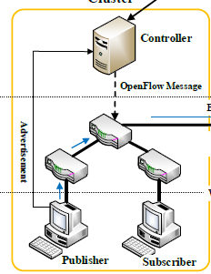
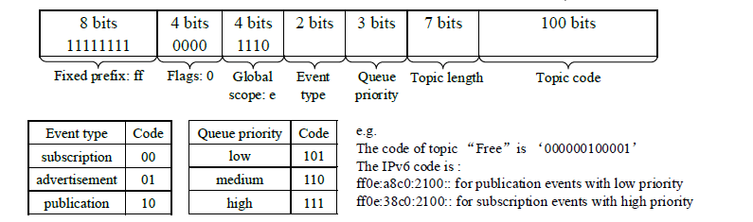
SDN based Pub Sub Architecture -2
Technology:
Open Daylight controller SDN controller on Ubuntu 18.04 (Control plane)
Mininet (SDN switch simulator) on ubuntu 18.04 for SDN switch (Data plane)
Python based Pub Sub application

Slide 7
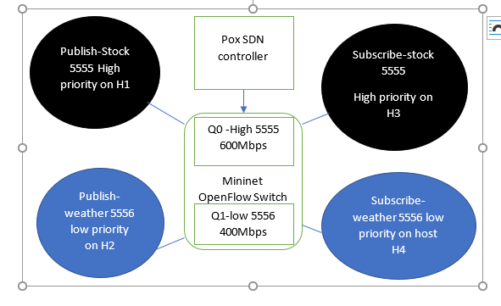
Pub SuB QoS using SDN
QoS of throughput is enforced between topics.
Stock topic is allocated higher bandwidth
Weather topic is allocated lower bandwidth
QoS is always enforced for different network scenario

Slide 8
Demo and outcome
Realize traditional Broker-based Pub-Sub(Kafka/Custom-based) on Chameleon Cloud (CC) or on laptop VM.
Realize SDN-based Pub-Sub using OpenDaylight (POX) SDN controller/POX controler and Mininet on CC (Chameleon Cloud).
Compare the response time/latency between them and see how faster the SDN-based Pub-Sub is.
QoS enforcement using 2 topics(1 High priority and 1 Low priority topic).

Slide 9
TeamWork
Ziqi’s work:
Read pyzmq documentations and found radio-dish pattern can be used for multicast;
Wrote sample pub and sub code with radio-dish pattern.
Designed and setup the experiment to compare the speed of network-layer Pub-Sub and traditional Pub-Sub.
Nithin’s work:
Designed the topic to IPv4 address encoding.
Created the multicast Publish middleware in pyzmq and python.
Implemented and tested the unicast based SDN based pub sub middleware with 2 topics (1 high priority and 1 low priority) for QoS enforcement in Mininet Openflow switch and POX SDN controller.
Implemented the experiment to enforce QoS among the topics of pub sub.

Slide 10
Status
Literature survey done
SDN Controller is installed and configured with Mininet.
Test topology is created.
The System architecture is designed/Finalized
Implemented and completed the Pub sub QoS experiment
Implemented and completed the Pub sub speed experiment

Slide 11
References, Q&A
Wang, Y.; Zhang, Y.; Chen, J. Pursuing Differentiated Services in a SDN-Based IoT-Oriented Pub/Sub System. In Proceedings of the 2017 IEEE International Conference on Web Services (ICWS), Honolulu, HI, USA,25–30 June 2017; pp. 906–909.
Shi, Yulong & Zhang, Yang & Jacobsen, Hans-Arno & Tang, Lulu & Elliott, Geoffrey & Zhang, Guanqun & Chen, Xiwei & Chen, Junliang. (2019). Using Machine Learning to Provide Reliable Differentiated Services for IoT in SDN-Like Publish/Subscribe Middleware. Sensors (Switzerland). 19. 10.3390/s19061449.

